Slide 1

MACHINE LEARNING BASED SYSTEM FOR PHISHING ATTACK DETECTION
Amritanshu shekher B.Tech. (CSE)
3rd semester
Section : E
Supervisor : Prof. (Dr.) Mohammad Wazid University Roll no.:2021083

Slide 2
INTRODUCTION AND STRUCTURE DIAGRAM
Phishing attacks have become anxiety for the cyber world. It causes enormous problems for privacy and financial issues of internet users. They send emails to steal the identity of legitimate users.
Phishing refers to an attempt to steal sensitive information, typically in the form of usernames, passwords, credit cards or other important data.
Traditional methods of detecting phishing attacks are proving insufficient in the face of evolving techniques used by cybercriminals.
To enhance our defense mechanisms, we present a cutting-edge solution - a Machine Learning-Based System for Phishing Attack Detection.

Slide 3
Problem statement
The objective of the proposed system is to design, develop and implement a machine learning-based system for the detection of phishing attacks. The focus is on to find the effective solution that can identify and classify phishing attempts with a high level of accuracy.

Slide 4
Methodology
Data Collection : Collect labeled dataset containing phishing and legitimate websites from the open source platform.
Data Preprocessing : Clean and preprocess the dataset by removing irrelevant features and missing values and converting it into a suitable format for machine learning algorithm.
Splitting data : Dataset is first shuffled and then split into train and test dataset.
Model Selection : Machine Learning models which are suitable for phishing attack detections are evaluated and chosen.

Slide 5
Methodology
Training the model : Model is trained from the trained dataset by using different machine learning models.
Evaluation Metrices : Evaluation metrices such as accuracy, precision , recall and F1 score are established to assess the performance of the machine learning model.
Validation and Testing : Testing the model that we created using test dataset and model is saved for the future use.

Slide 6
Result and discussion
In this project, we successfully developed and evaluated machine learning models for phishing attack detection using various algorithms, including Decision Tree, Random Forest, XGBoost, and Support Vector Machine (SVM). The dataset, containing URL features and labels indicating whether a URL is associated with phishing, was preprocessed, explored, and used to train and test the models. The models were evaluated based on accuracy, classification reports, and confusion matrices.

Slide 7
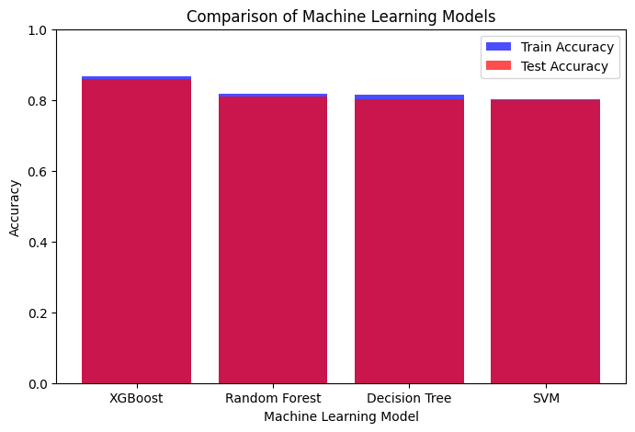
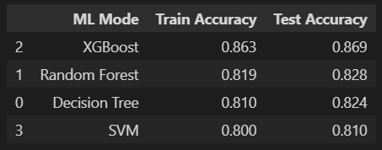
Result and discussion
From the evaluation of the model from the trained and test dataset, we get accuracy of the 86% and XGBoost gives the highest accuracy for the model.
Different models are visualized on the basis of their accuracy with the help of graphical representation.

Slide 8
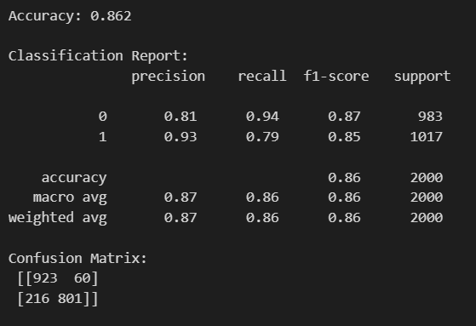
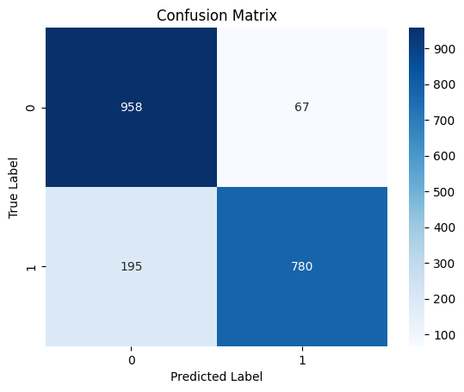
Result and discussion
The confusion matrix, F1 score and the accuracy of the matrix model

Slide 9
Conclusion
In this project, we successfully developed and evaluated machine learning models for phishing attack detection using various algorithms, including Decision Tree, Random Forest, XGBoost, and Support Vector Machine (SVM). The dataset, containing URL features and labels indicating whether a URL is associated with phishing, was preprocessed, explored, and used to train and test the models. The models were evaluated based on accuracy, classification reports, and confusion matrices. All the four classifiers gave promising results with the best being XGBoost Classifier with an accuracy score of 86%. The accuracy score might vary while using other datasets and other algorithms might provide better accuracy than XGBoost classifier.

Slide 10
Future work
Further work can be done to enhance the model by using ensembling models to get greater accuracy score. Different models can be used to increase the accuracy of the model for the better prediction of the phishing attack. Regularly update the model with new data to adapt to evolving URL patterns and ensure its effectiveness over time. Ensemble methods is a ML technique that combines many base models to generate an optimal predictive model. Further reaching future work would be combining multiple classifiers, trained on different aspects of the same training set, into a single classifier that may provide a more robust prediction than any of the single classifiers on their own.

